Slide 1
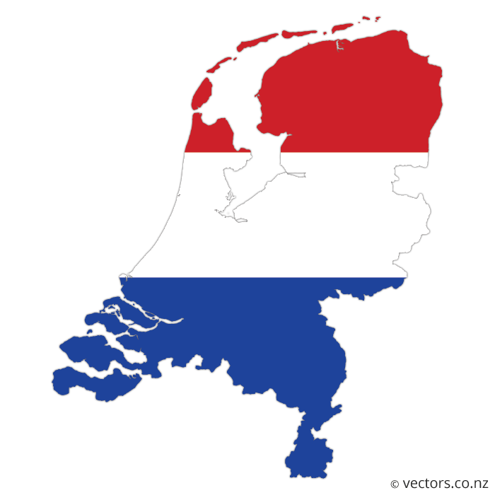
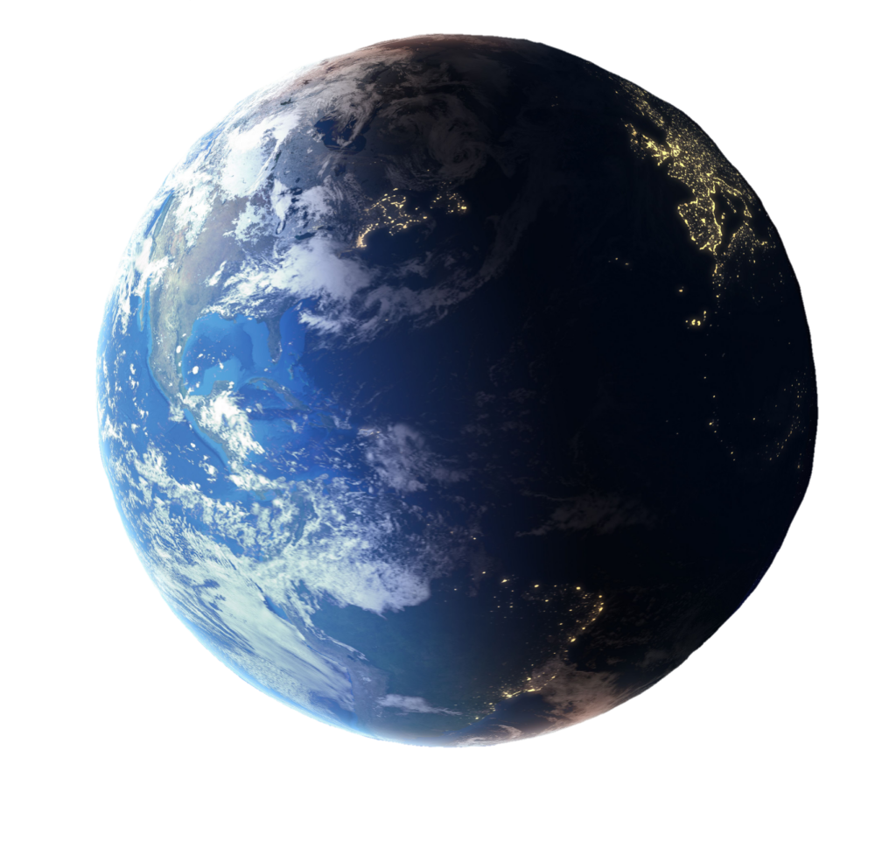
Dutch Overshoot Day 2024 op 1 April
Als iedereen zou leven zoals wij doen, zouden we 4 aardes nodig hebben.

Slide 2
Dutch Overshoot Day 2024 on 1st of April
If everyone on earth lived as the Dutch, we would need 4 earths

Slide 3
Dutch Overshoot Day 2024 on 1st of April
If everyone on earth lived as the Dutch, we would need 4 earths

Slide 4
Dutch Overshoot Day 2024 on 1st of April
If everyone on earth lived as the Dutch, we would need 4 earths

Slide 5
st
Dutch Overshoot Day 2024 on 1st of April
4 Earths
If everyone on earth lived as the Dutch, we would need 4 earths

Slide 6
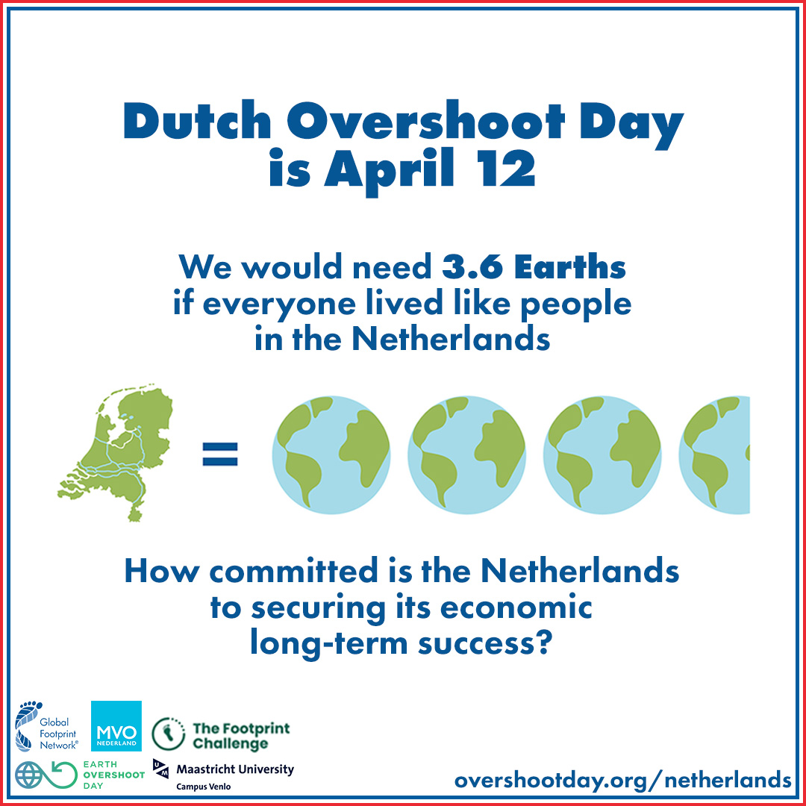
st
4 Earths

